Slide 1

Nature’s Fresh Mart WIP Presentation
Project Manager: Rohit Pandey
The British College

Slide 2



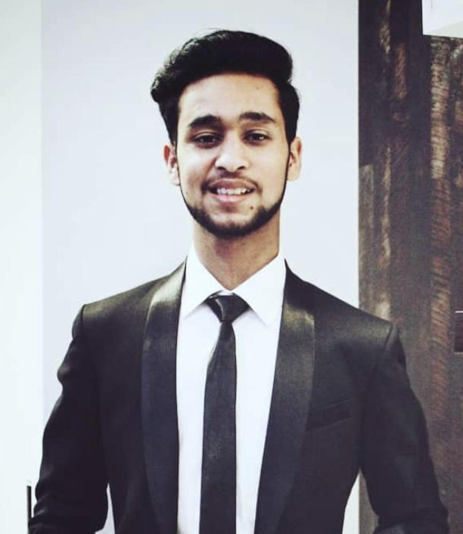
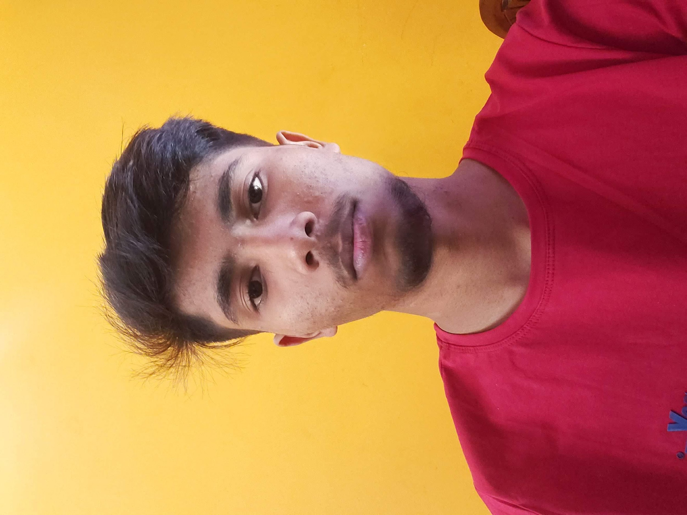
Meet Our Team
Saugat Thapa
Co-Ordinator
Plant
Shaper
Rajesh Basnet
Specialist
Complete Finisher
Resource Investigator
Aakash Das
Resource Investigator
Team Worker
Implementer
Gaurav Bhansali
Shaper
Team Worker
Plant
Harsh Gupta
Team Worker
Monitor Evaluator
Complete Finisher

Slide 3
Website Logo

Slide 4
Overview
Independently owned local businesses located at a popular suburb of Cleckhuddersfax have decided to create an e-commerce platform.
This platform helps the traders sell their fresh goods more conveniently.
Locals can now buy locally sourced fresh high quality foods at any time of the day.
With the help of the platform traders hope to increase their revenue, recognition and reach a larger market.

Slide 5
Entity Relationship Diagram
1

Slide 6
Composite
Diagram

Slide 7
Use Case Diagram
2

Slide 8
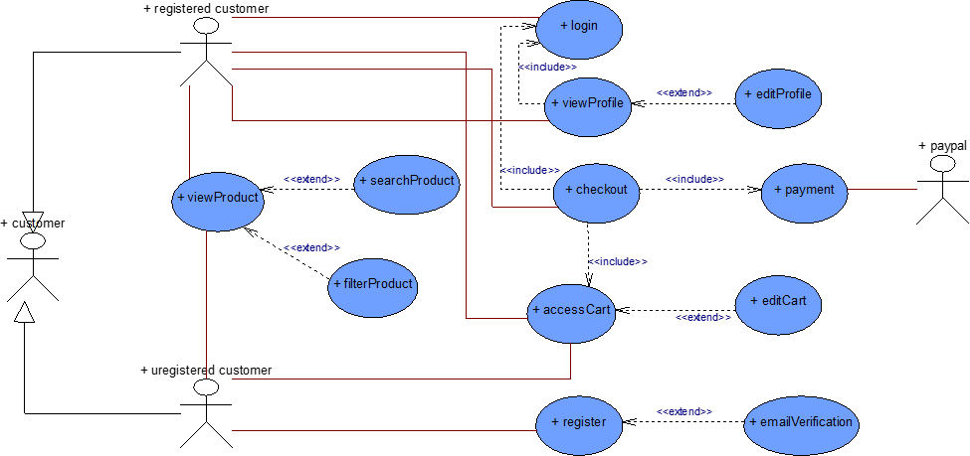
Customer
Use Case

Slide 9
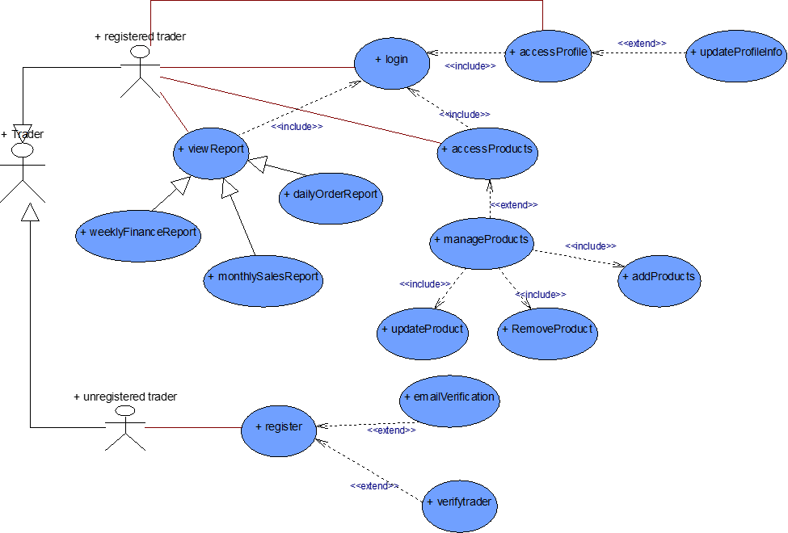
Trader
Use Case

Slide 10
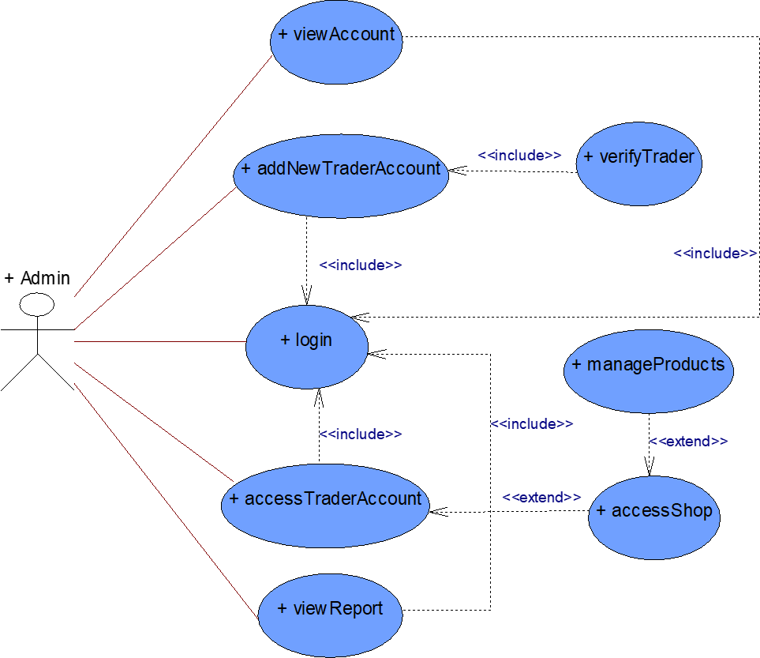
Admin
Use Case

Slide 11
Use Case
Overview

Slide 12
Skills Audit
3
Let’s start with Skills Audit slides

Slide 13
NO# | Skill Required | Skill Level ( 1- 5) | Traning Action | Training Objective | Time (hrs) | Training Completion Deadline | Traning for?
1 | HTML | 3.7 | Revise HTML from W3Schools and learn new HTML5 templates. | Become better in creating basic structure of webpages | 21 | 04/06/2021 | Harsh, Gaurav, Saugat
2 | CSS | 3.3 | Follow w3schools,tutorialspoint and Youtube. | Refresh my knowledge on basic css tags and make the pages attractive. | 28 | 04/06/2021 | Gaurav , Harsh, Saugat
3 | JavaScript | 2.2 | Revise ES6 and learn from notes as well as MDN. | To make website user friendly by making cart buttons,number of goods left/payment method | 49 | 06/06/2021 | Harsh, rajesh , saugat
4 | Bootstrap | 2.7 | Follow official Bootstrap document and also take a guide from Youtube. | To make web pages more stylish and responsive. | 37 | 08/06/2021 | gaurav, harsh , saugat
5 | jQuery Plugins | 2.1 | Follow youtube tutorials and follow websits like w3schools, tutorialspoint, etc. | To be able to use the jQuery library to write better javascript easily | 26 | 06/06/2021 | gaurav, harsh , saugat
6 | PHP | 3 | Revise and learn all the syntax from W3Schools. | Become more confident in handling backend and database | 46 | 6/18/2021 | harsh, rajesh ,saugat
7 | MySQL | 3.1 | Review from different websites and youtube videos | To use database more efficiently and learn different syntax. | 21 | 15/06/2021 | harsh, gaurav, rajesh, saugat
8 | Apache | 2.6 | Revise previous module course and go through youtube,google for further study | To run web pages and PHP in host environment. | 13 | 16/05/2021 | gaurav, harsh , saugat
9 | Photoshop | 2.8 | Look for solutions to sepcific parts we may need during the duration of the project on youtube and google and be able to perform those acitons efficiently | To re-create or edit images of different MIME types for implementations in websites. | 28 | 05/06/2021 | aakash, harsh, rajesh

Slide 14
10 | Illustrator | 2.5 | Watch videos on youtube related to objects creation and different features. | To make innovative images and for different objects. | 31 | 6/10/2021 | aakash, harsh, rajesh
11 | Mockflow | 2.5 | Play around in the mockflow environment and ask for help with teammates if needed. | To be able to protoype wireframe and produce a skeleton of the website to be created | 22 | 6/5/2021 | gaurav, harsh , aakash
12 | Figma | 2.4 | Watch videos related to UI/UX design on youtube which uses figma | To create prototype for building websites. | 24 | 6/2/2021 | gaurav, harsh , rajesh
13 | Qsee | 3.1 | Revise previous module course and go through youtube,google for further study | To be confident in drawing Erd,eerd,use-case models,network model | 20 | 5/20/2021 | gaurav, harsh , rajesh, saugat
14 | API | 1.5 | Learn and explore different API from Youtube as well as Google. | To interact with external software components and microservices. | 46 | 6/21/2021 | harsh, rajesh , saugat
15 | Sandbox | 1 | Follow the related videos of the sandbox and take a guide from Youtube or Google. | To implement payment scheme for the use of PayPal using Sandbox | 57 | 6/22/2021 | harsh, gaurav, rajesh, aakash
16 | MS-Project | 1.1 | Follow youtube tutorials and google, lastly instruction from tutor | To handle projects maintaing schedule, assigning resources to tasks and managing workloads. | 39 | 5/24/2021 | gaurav, rajesh, saugat
17 | Ms-Word | 4.3 | Use it daily taking help from youtube if needed | To be able to easily document meeting notes, produce reports etc professionally | 8 | 5/11/2021 | aakash, harsh, saugat
18 | Ms-Excel | 3.9 | Play around in excel and look for solutions of specific problems we may encounter on youtube or google | To be able to maintain tables , create columns with specific data types , use formulas on different columns, etc | 10 | 5/12/2021 | aakash, harsh, rajesh
19 | Discord | 3.9 | Follow youtube tutorials to learn to create things like bots, chat rooms and voice channels | To be able to conduct regular meetings regarding project management | 12 | 5/11/2021 | gaurav, harsh, saugat

Slide 15
MS-Project
4

Slide 16
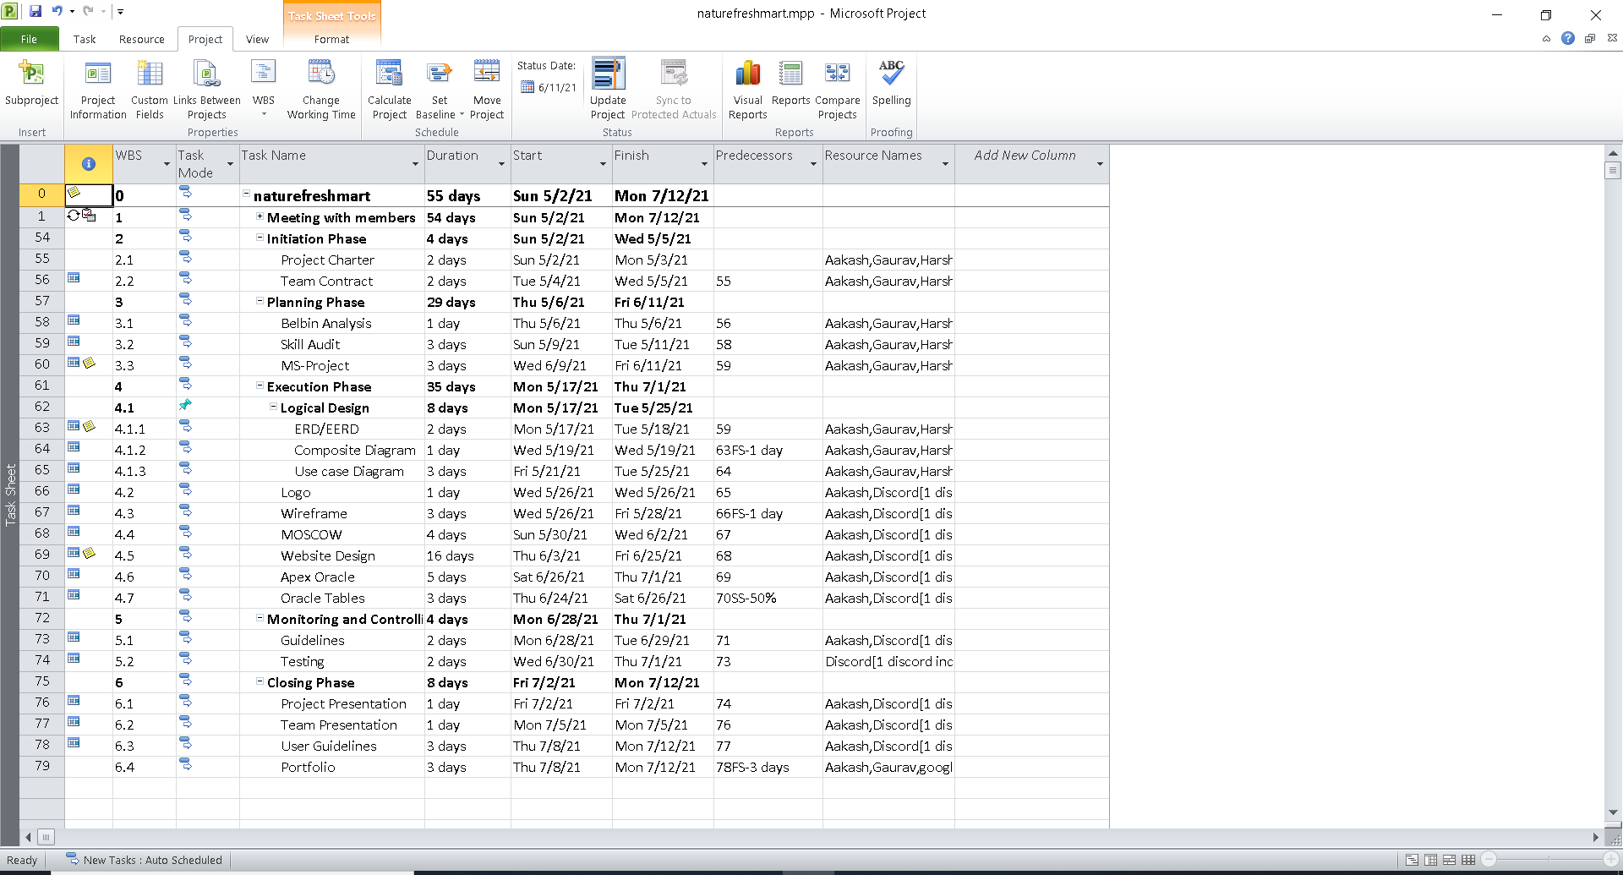
Task Sheet

Slide 17
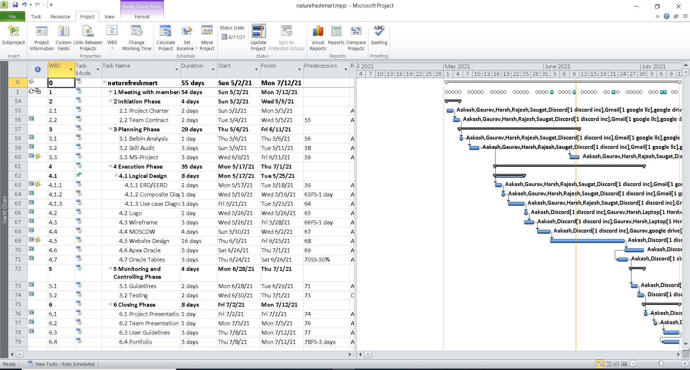
Gantt Chart

Slide 18
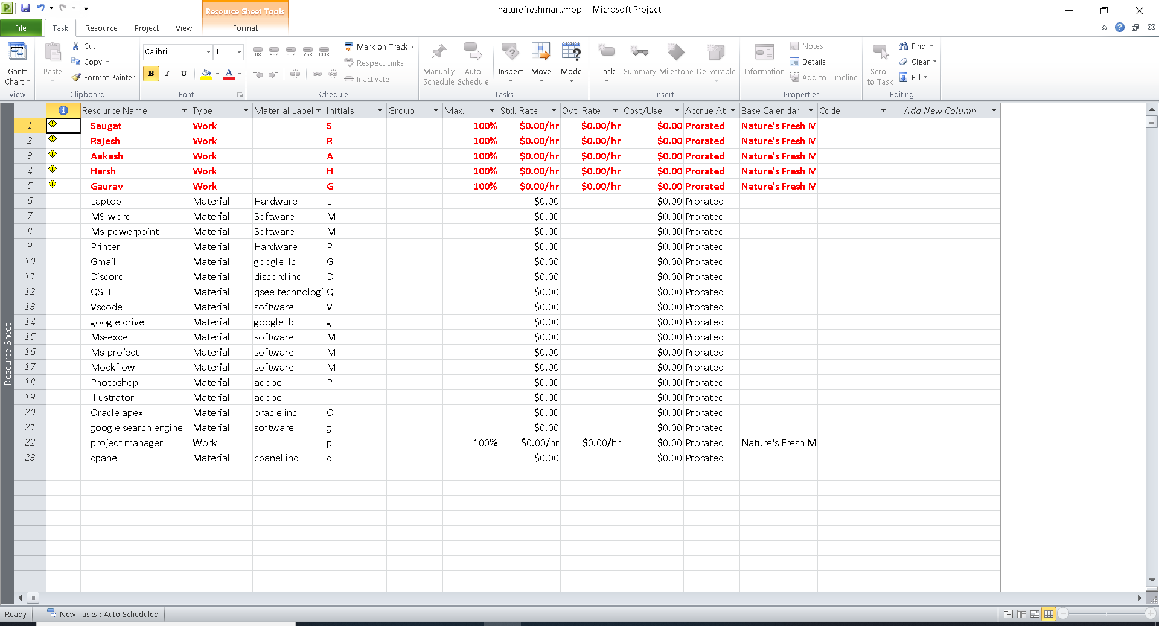
Resource Sheet

Slide 19
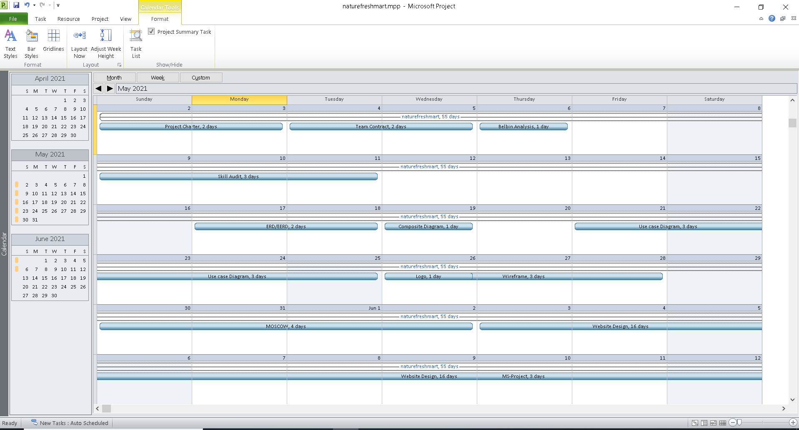
Calendar

Slide 20
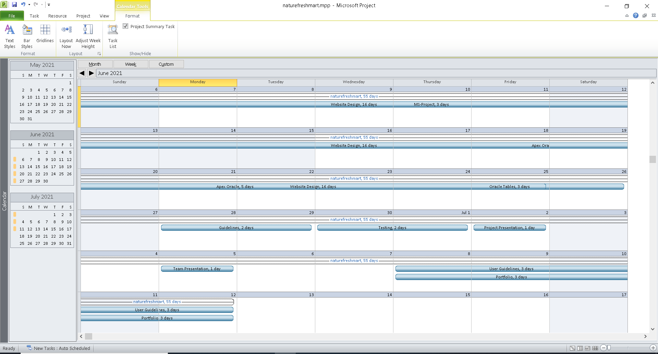
Calendar

Slide 21
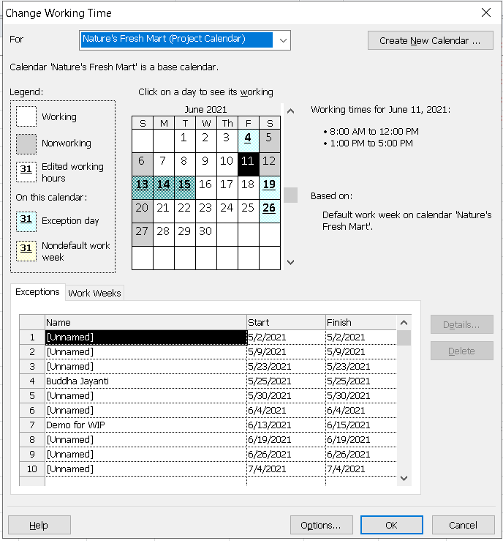
Project Calendar

Slide 22
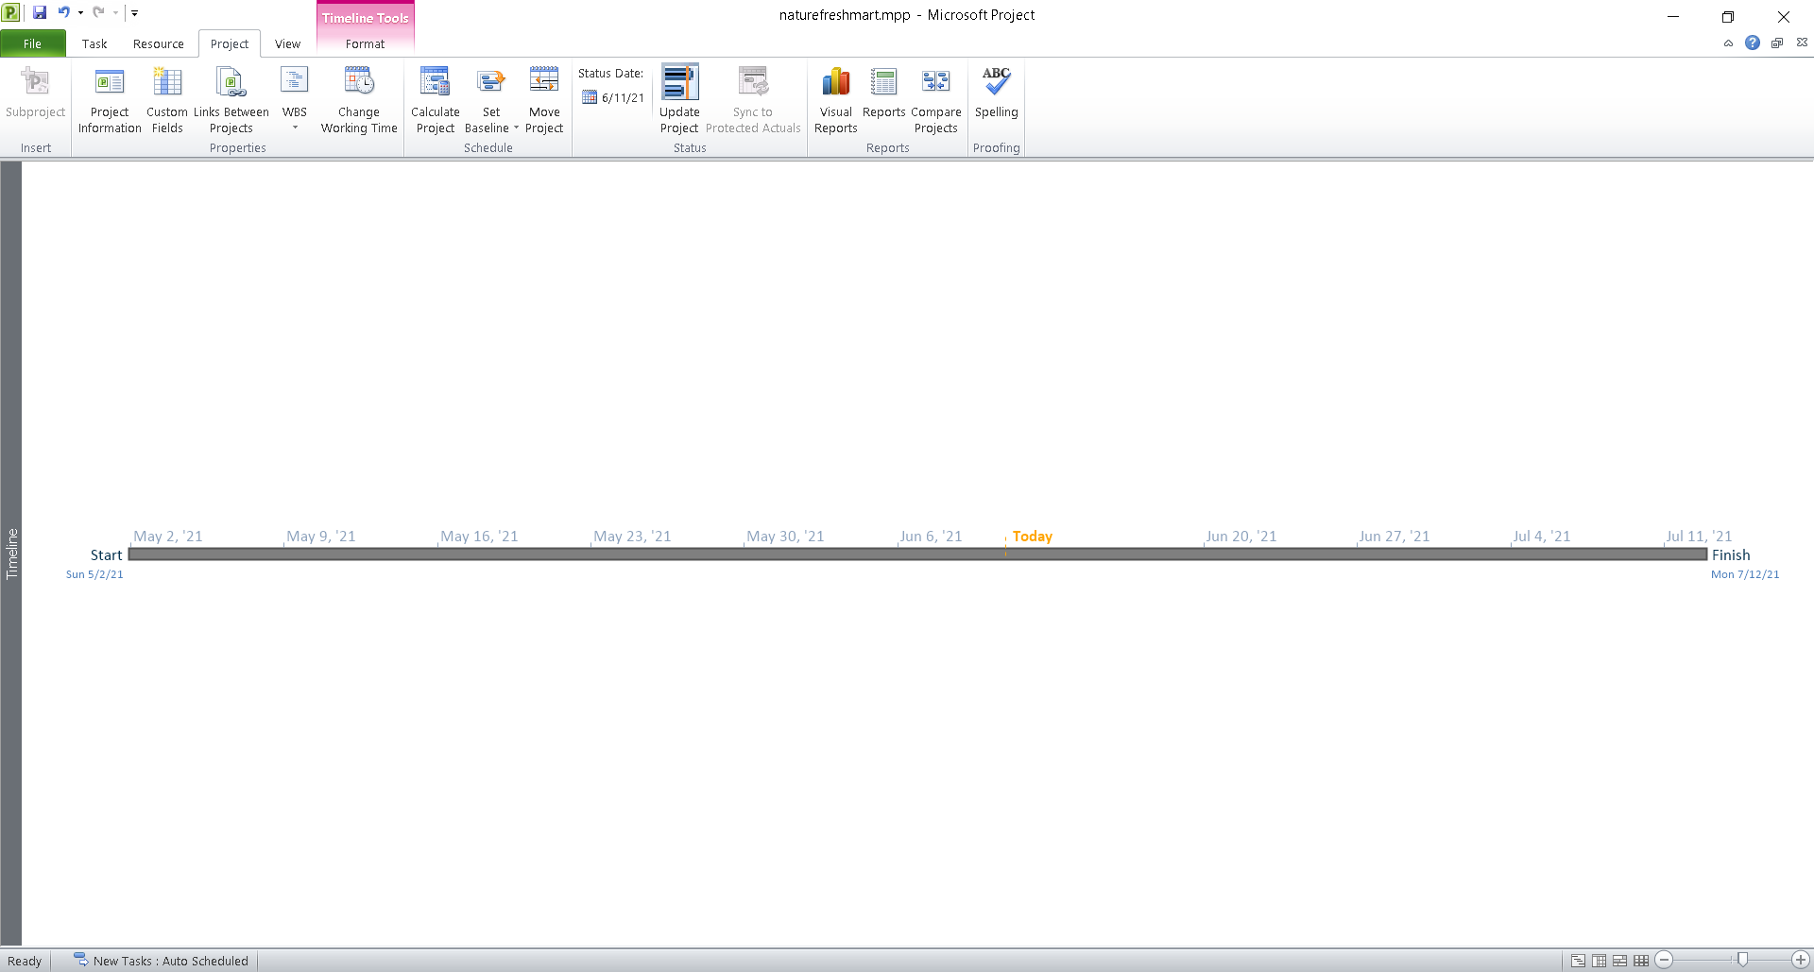
Timeline

Slide 23
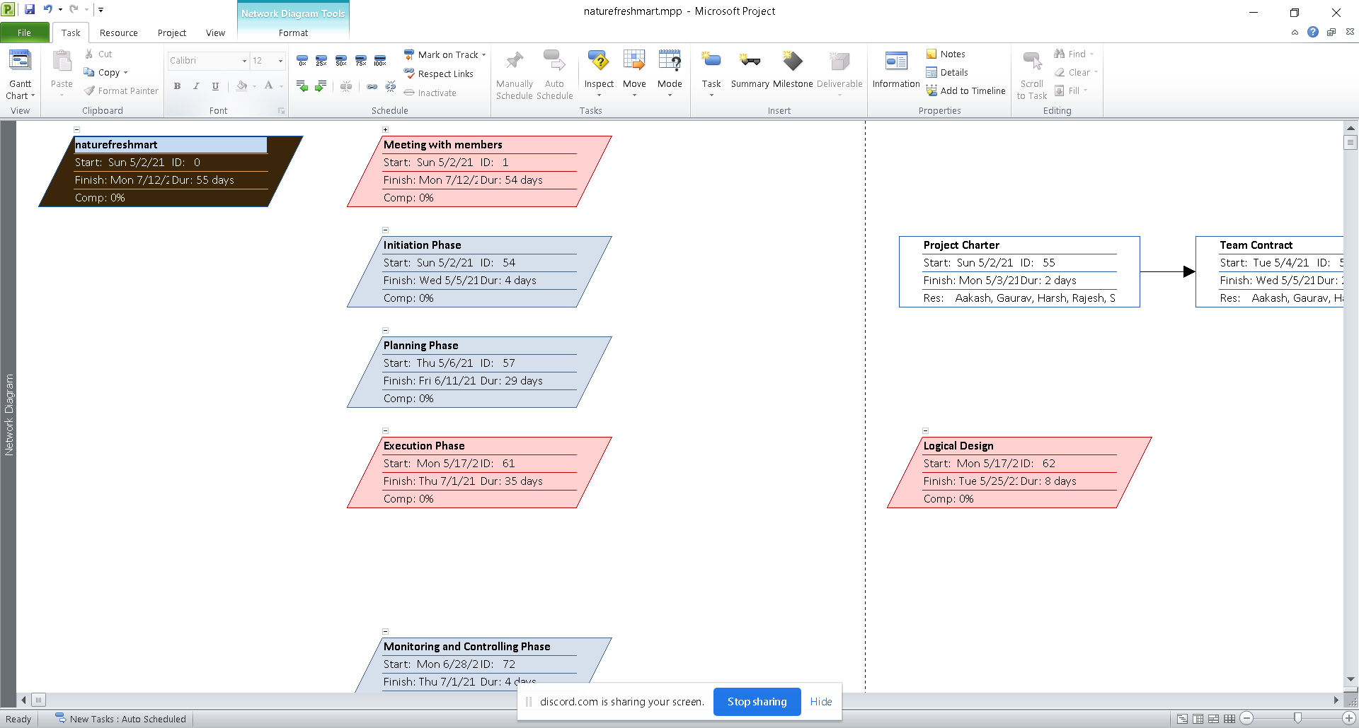
Network Diagram

Slide 24
Requirements
5

Slide 25
Functional Requirement

Slide 26
Part A: Product

Slide 27
REQUIREMENT ID | DESCRIPTION | MOSCOW RULE
A1 | Product description
A1-01 | Products will have a unique id. | M
A1-02 | Products will have a name and price. | M
A1-03 | Products will be associated with at least one trader. | M
A1-04 | Products will have max and min order capacity , stock availability and description. | M
A1-05 | Products will have allergy information if needed. | S
A1-06 | Products will have an enabled or disabled status. | S
A1-07 | Products will have delivery-storage information. | C

Slide 28
Part B: Customer Interface

Slide 29
REQUIREMENT ID | DESCRIPTION | MOSCOW RULE
B1 | An Interface that allows the customers to view and buy products
B1-01 | Customers will be able to sort products according to name and price. | M
B1-02 | Customers will be able to search for products inside each shop. | M
B1-03 | Customers will be able to view information about products like price, stock and so on. | M
B1-04 | Customers will be able to rate and leave reviews on products. | S
B1-05 | Customers will be able to search for products directly from the home page. | C
B2 | Cart interface for customers
B2-01 | Customers will be able to add products to a single cart from different shops. | M
B2-02 | Customers will be able to view the total price. | M
B2-03 | Customers will be able to delete items from the cart individually or all at once. | S
B2-04 | Customers will be able to add more of the same products from the cart itself. | C

Slide 30
B3 | Product payment and collection
B3-01 | Customers will be able to make online payments via PayPal. | M
B3-02 | Customers will be able to login to their account. | M
B3-03 | Customers will be able to view their orders. | M
B3-04 | Customers will be able to choose collection slots. | M
B3-05 | Customers can add products to favourites if they are logged in. | C
B3-06 | Customers can remove items from favourites. | C
B3-07 | Customers will be able to cancel orders after they have been placed. | C
B3-08 | Customers will be able to return products that are not satisfied with the quality. | C

Slide 31
Part C: Trader Interface

Slide 32
REQUIREMENT ID | DESCRIPTION | MOSCOW RULE
C1 | An Interface that allows the traders to manage their products
C1-01 | All products of every trader will have their unique trader ID. | M
C1-02 | All traders will have at least one shop each. | M
C1-03 | Traders will be able to manage their personal information excluding passwords. | M
C1-04 | Traders will be able to update, insert and delete products. | M
C1-05 | Each trader should have at least one product. | M
C1-06 | Traders should be able to login to their account. | M
C1-07 | Traders will be able to change their password by and type of product by themselves without the help of admin. | C

Slide 33
C2 | Payment of the trader
C2-01 | Each trader will receive a receipt for each item sold which can be accessed using their accounts. | M
C2-02 | Each trader will receive a single receipt for all items sold that day which can be accessed using their accounts. | C
C3 | Daily, weekly and Monthly Reports
C3-01 | All reports will be available to the traders after they’ve logged in. | M
C3-02 | Daily reports will be available to the traders after they’ve logged in. | M
C3-03 | Weekly financial reports will be available to the traders after they’ve logged in. | M
C3-04 | Monthly sales reports will be available to the traders after they’ve logged in. | M

Slide 34
Part D: Login & Registration

Slide 35
REQUIREMENT ID | DESCRIPTION | MOSCOW RULE
D1 | An Interface that allows customers to login or register
D1-01 | Customers will be able to login using username and password. | M
D1-02 | New customers will be required to fill out a form which will minimally require name, email and password. | M
D1-03 | Email verification links will be sent for customer verification. | M
D1-04 | Server side validation for user login. | S
D1-05 | Login option will be available on each page if the user is not logged in. | S
D1-06 | Server side validation for incorrect login attempt. | S

Slide 36
D2 | An Interface that allows trader to login or register
D2-01 | New traders will be required to fill out a form that collects first name, last name, email, address, mobile number, password and terms and conditions checkbox. | M
D2-02 | Email verification links will be sent for trader verification. | M
D2-03 | Traders will be able to login to their account using username and password. | M
D2-04 | Server side validation for trader login. | S
D2-05 | Server side validation for incorrect login attempt. | S
D2-06 | Apply appropriate strategies to ward off potential security threats. | C

Slide 37
Part E: Management Interface

Slide 38
REQUIREMENT ID | DESCRIPTION | MOSCOW RULE
E1 | An Interface that allows admin to login
E1-01 | Admins will login using their username and password. | M
E1-02 | After logging in, admin can access any of the trader accounts. | S
E1-03 | Admin can disable any trader’s products | S
E1-04 | Admin can deactivate a trader's account. | C
E1-05 | Admin can delete a trader's products. | C
E2 | Dashboard and Report
E2-01 | Admin users can access the admin home page and dashboard. | M
E2-02 | Admin has access to all reports of the traders. | M

Slide 39
Non-functional Requirement

Slide 40
REQUIREMENT ID | DESCRIPTION | MOSCOW RULE
NF1 | An Interface that allows admin to login
NF-01 | The website will be scalable so future development in the website is feasible. | M
NF1-02 | The website load time won't exceed 5 seconds. | S
NF1-03 | Server side validation for all users login. | M
NF1-04 | Proper documentation of code for code maintainability. | M
NF1-05 | High level of security for online payment transactions. | S
NF1-06 | The traders will be notified no later than 12 hours after registration. | S
=NF1-07 | The customer can access the cart from any shop page or product page directly. | M

Slide 41
Wireframe
6

Slide 42
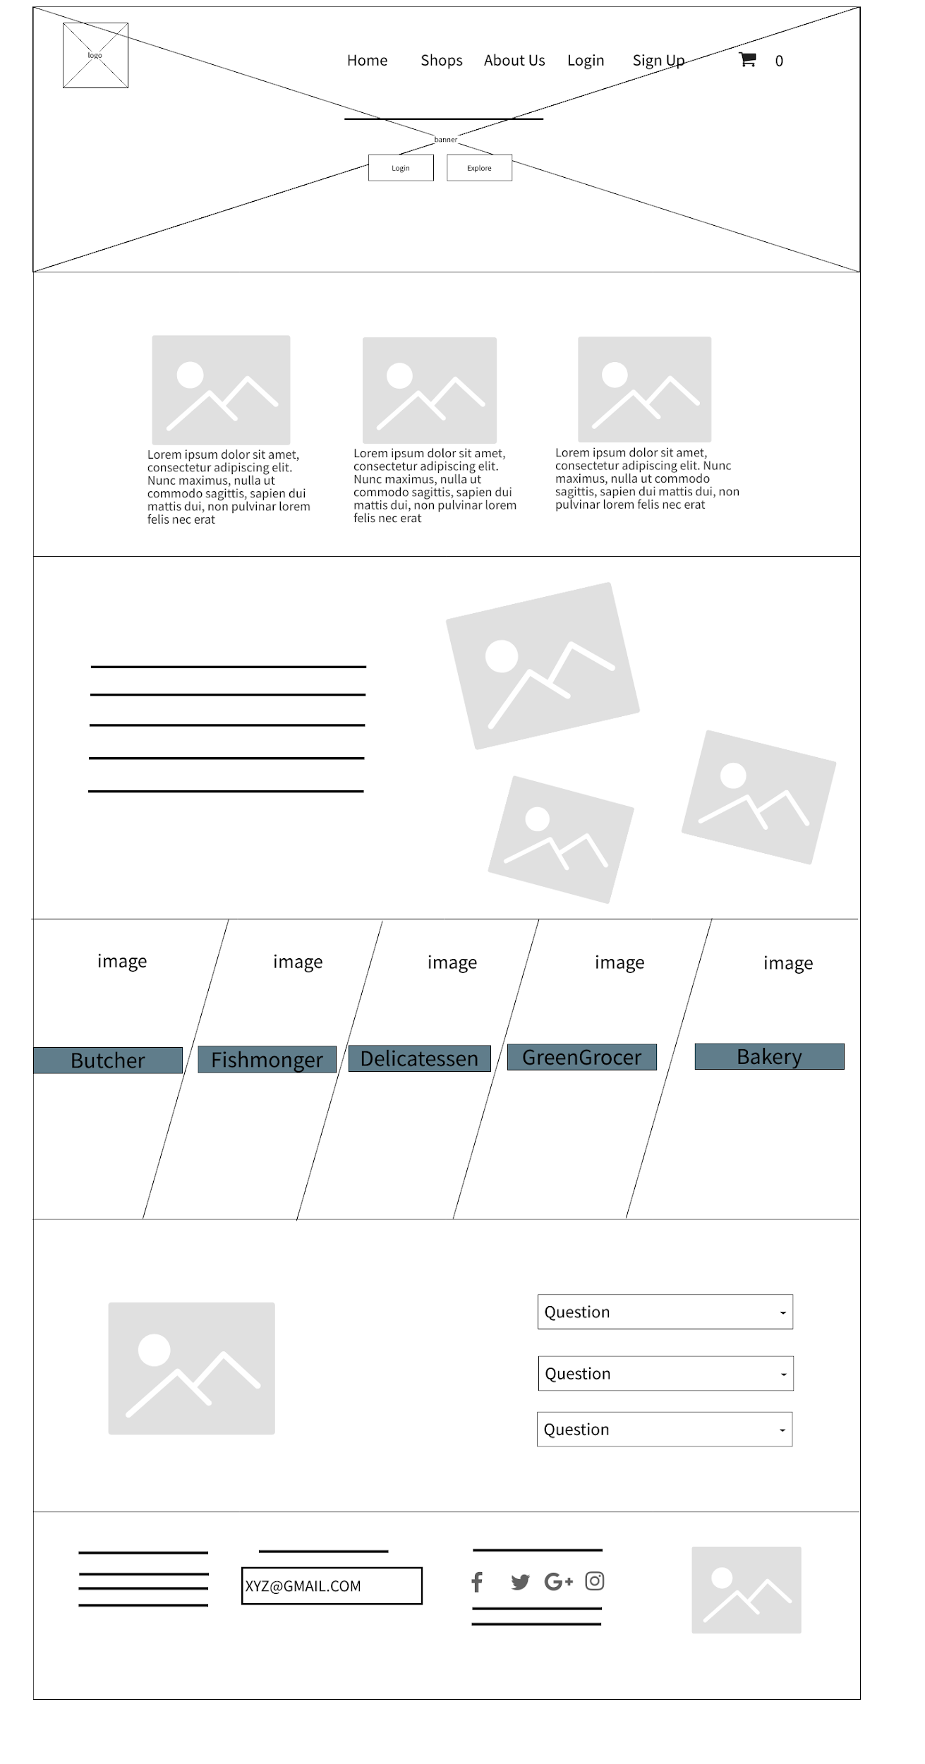

Home

Slide 43
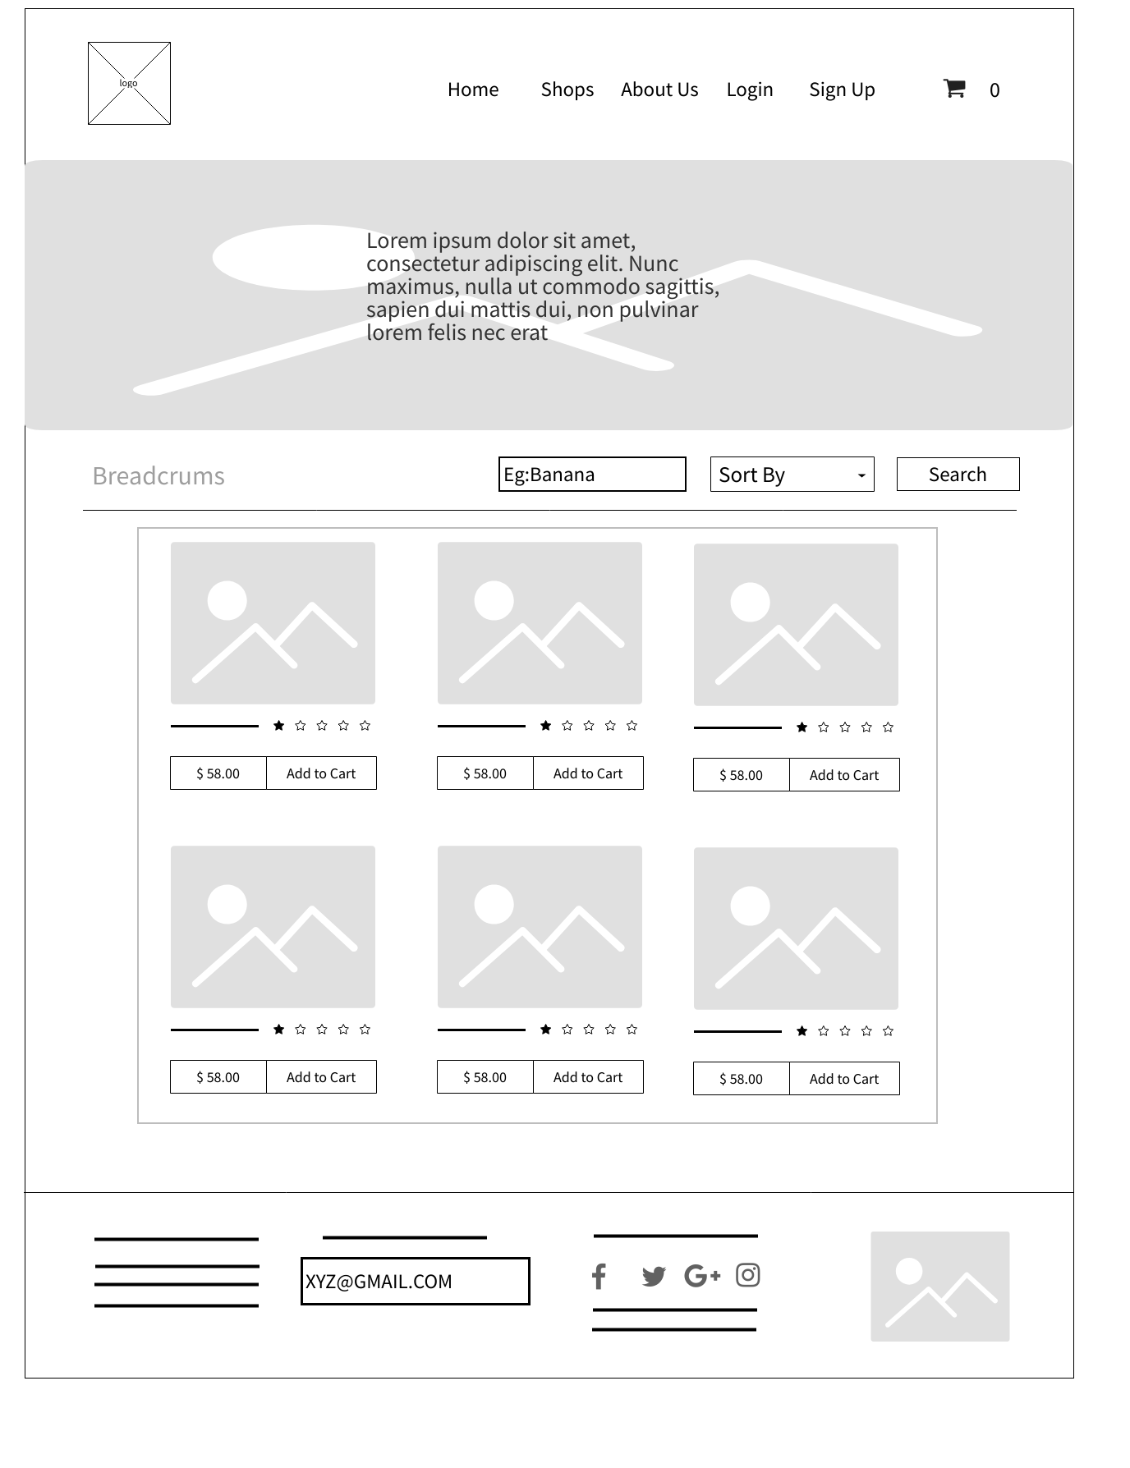
Shop

Slide 44
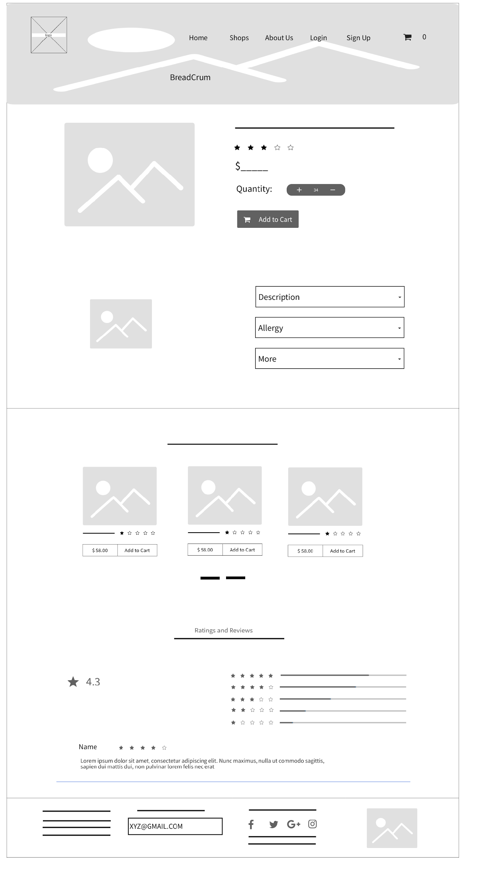
Individual product

Slide 45
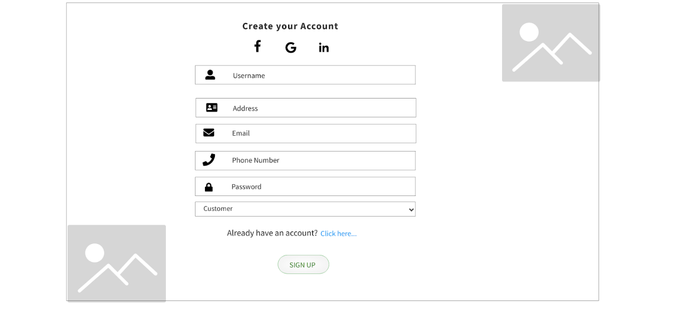
Sign Up Customer

Slide 46
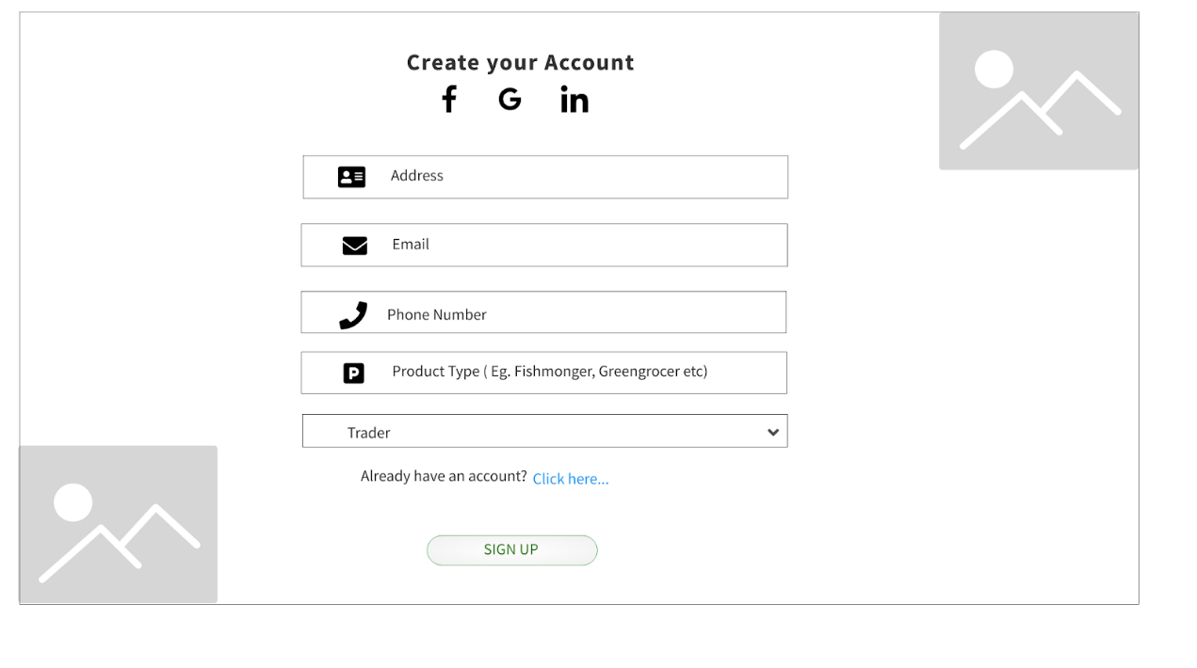
Sign Up Trader

Slide 47
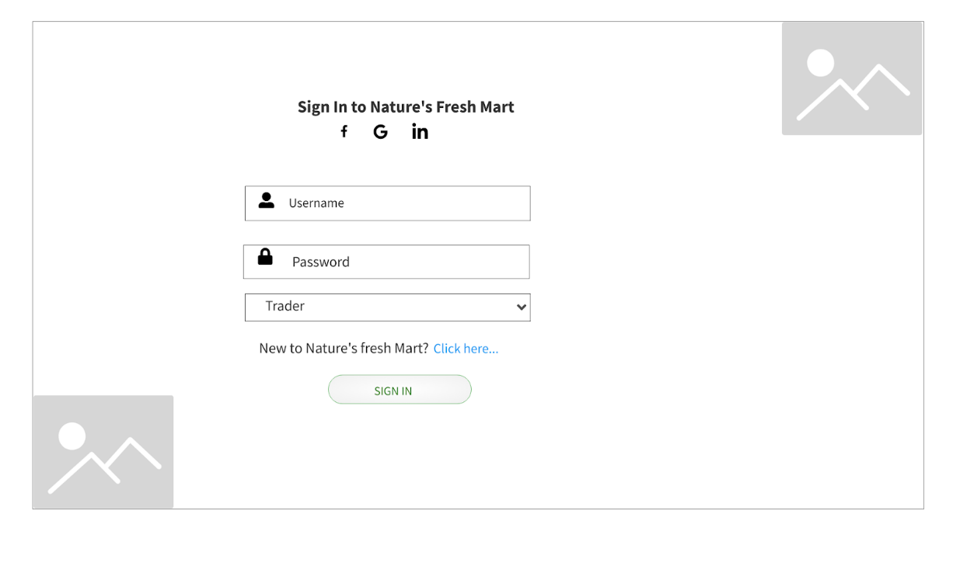
Sign In Trader/Admin/
Customer

Slide 48
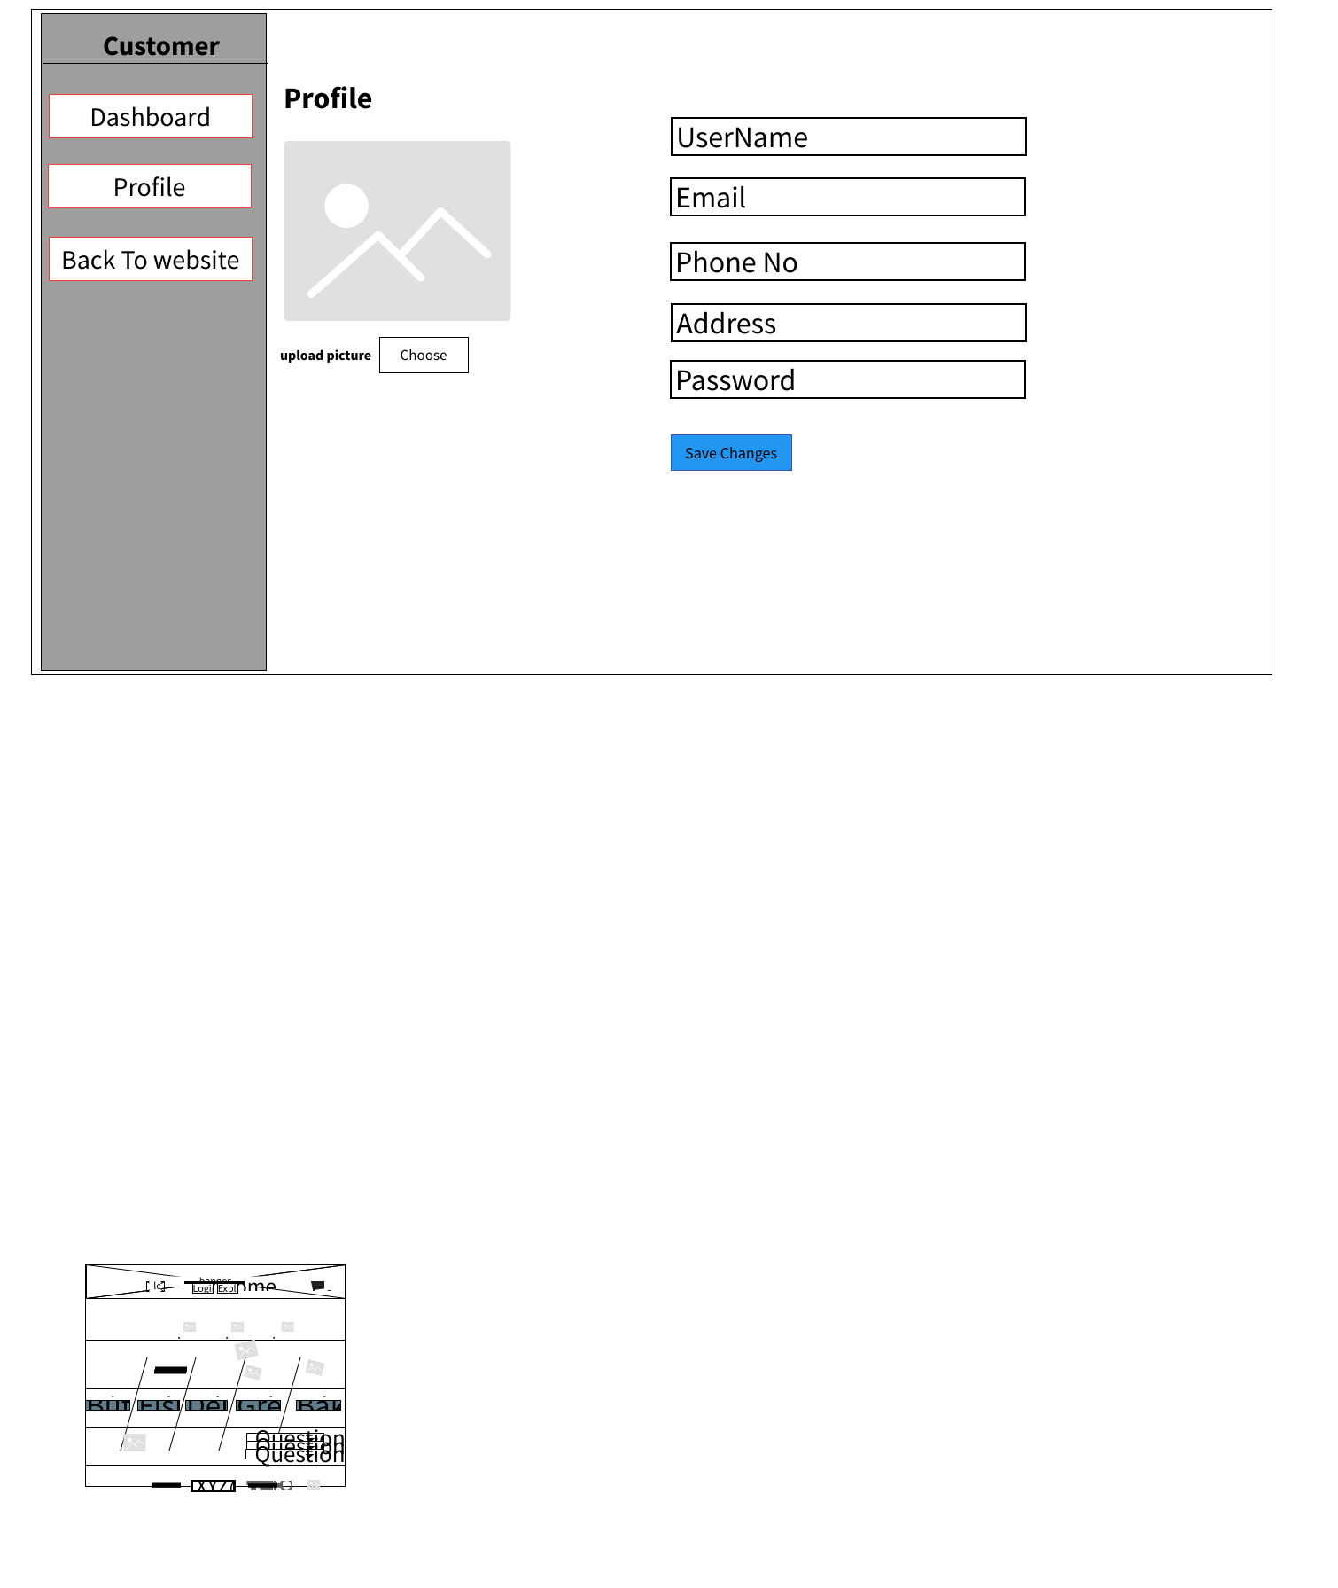
Customer Profile Setting (PhP)

Slide 49
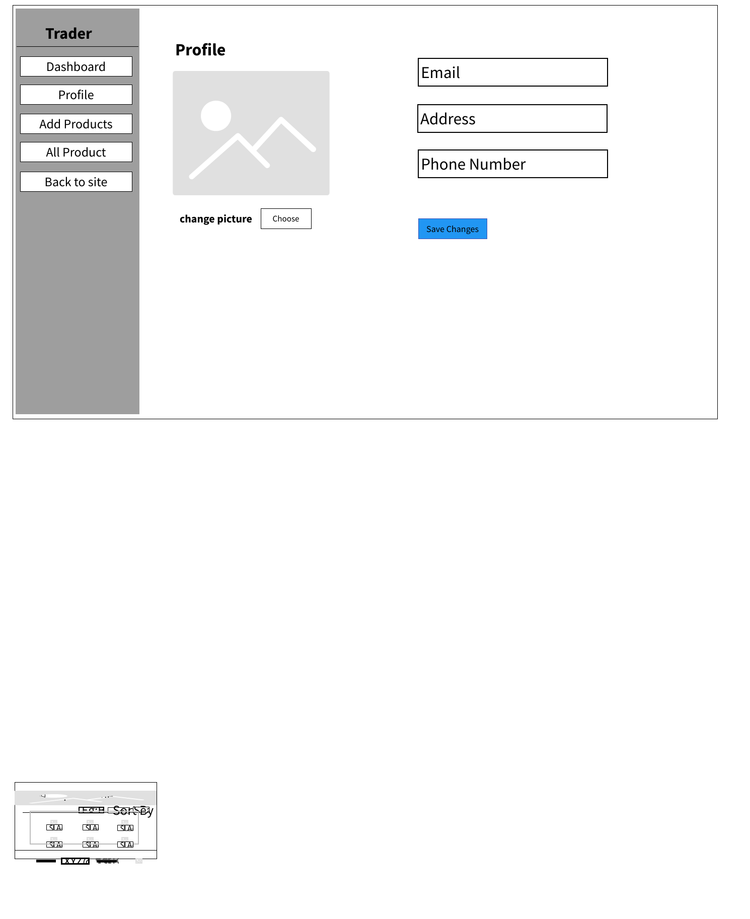
Trader Interface (PhP)

Slide 50
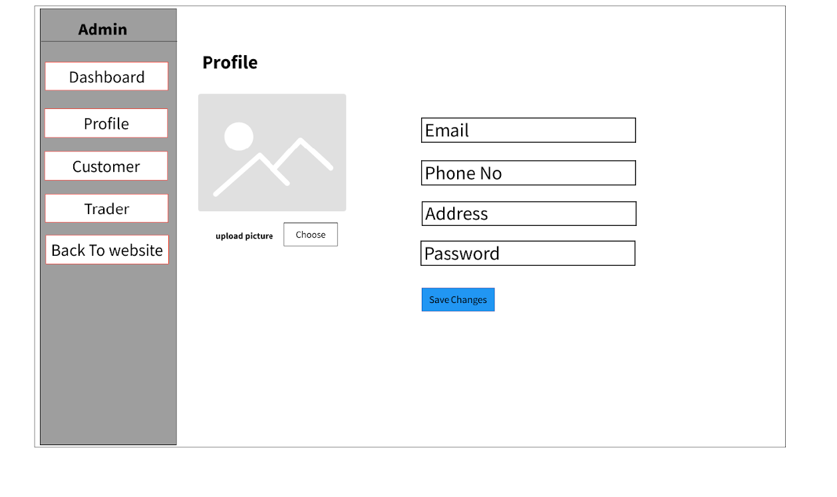
Admin Interface (PhP)

Slide 51
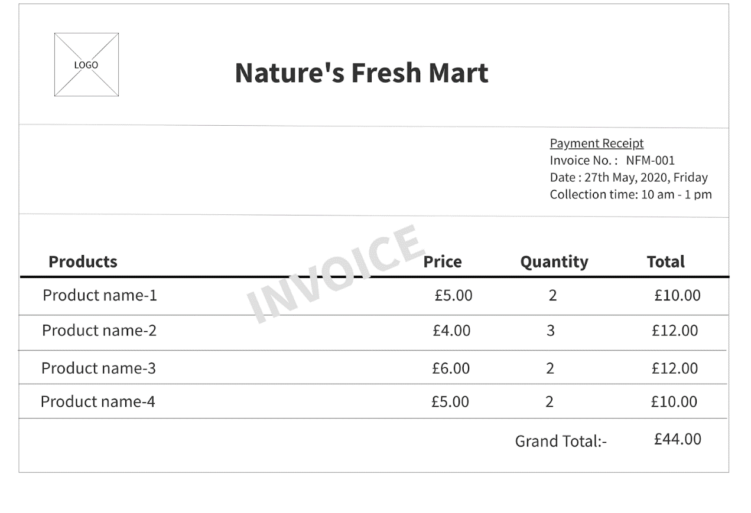
Invoice

Slide 52
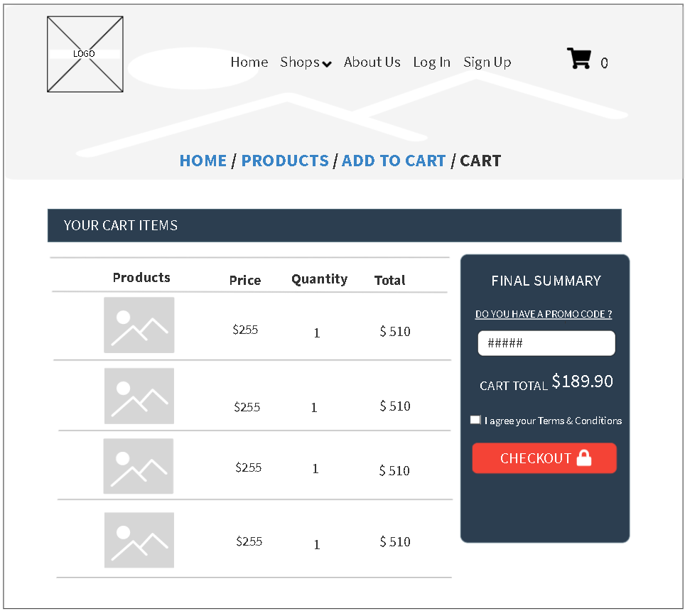
Cart

Slide 53
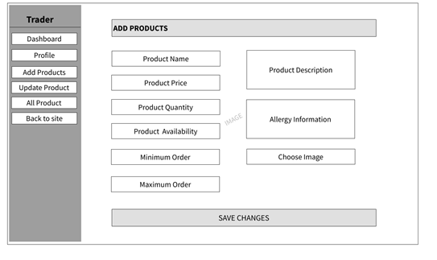
Add Product

Slide 54

Update Product

Slide 55
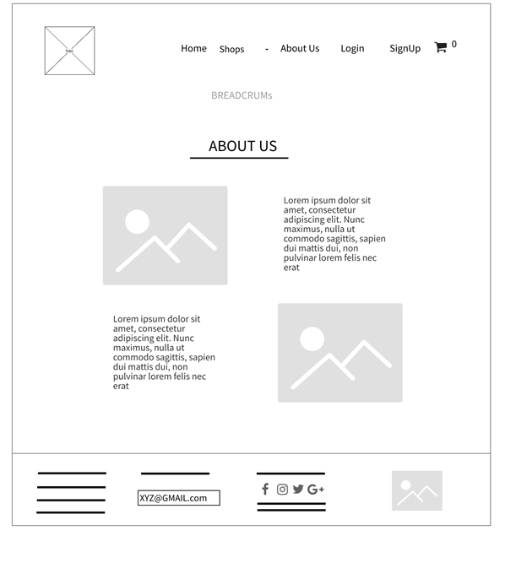
About Us

Slide 56
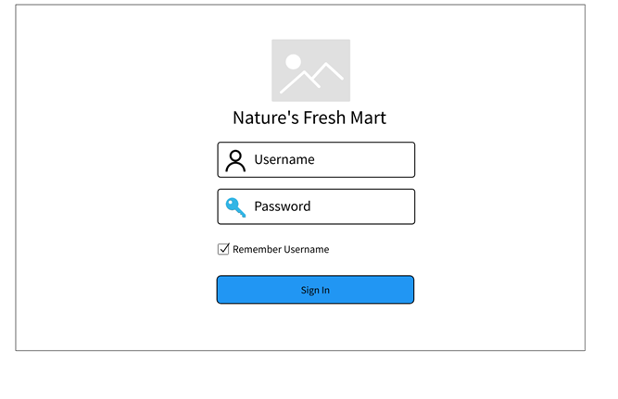
Oracle Apex

Slide 57
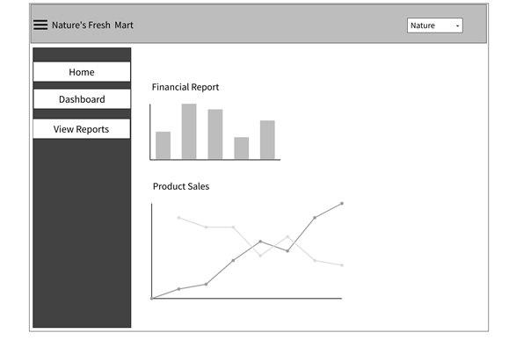
Oracle Apex

Slide 58
Product Development Progression
7

Slide 59
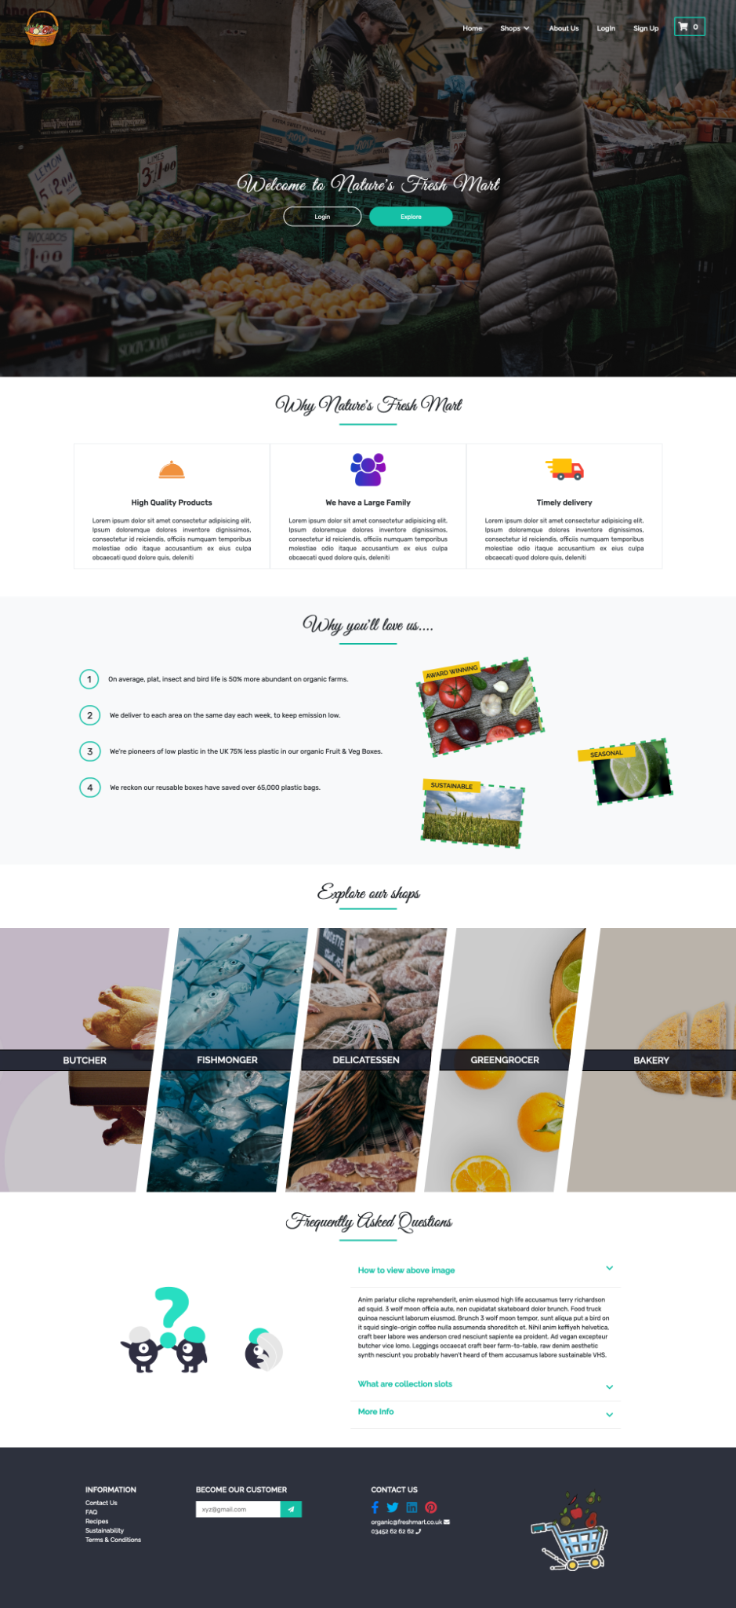
Home page Section

Slide 60
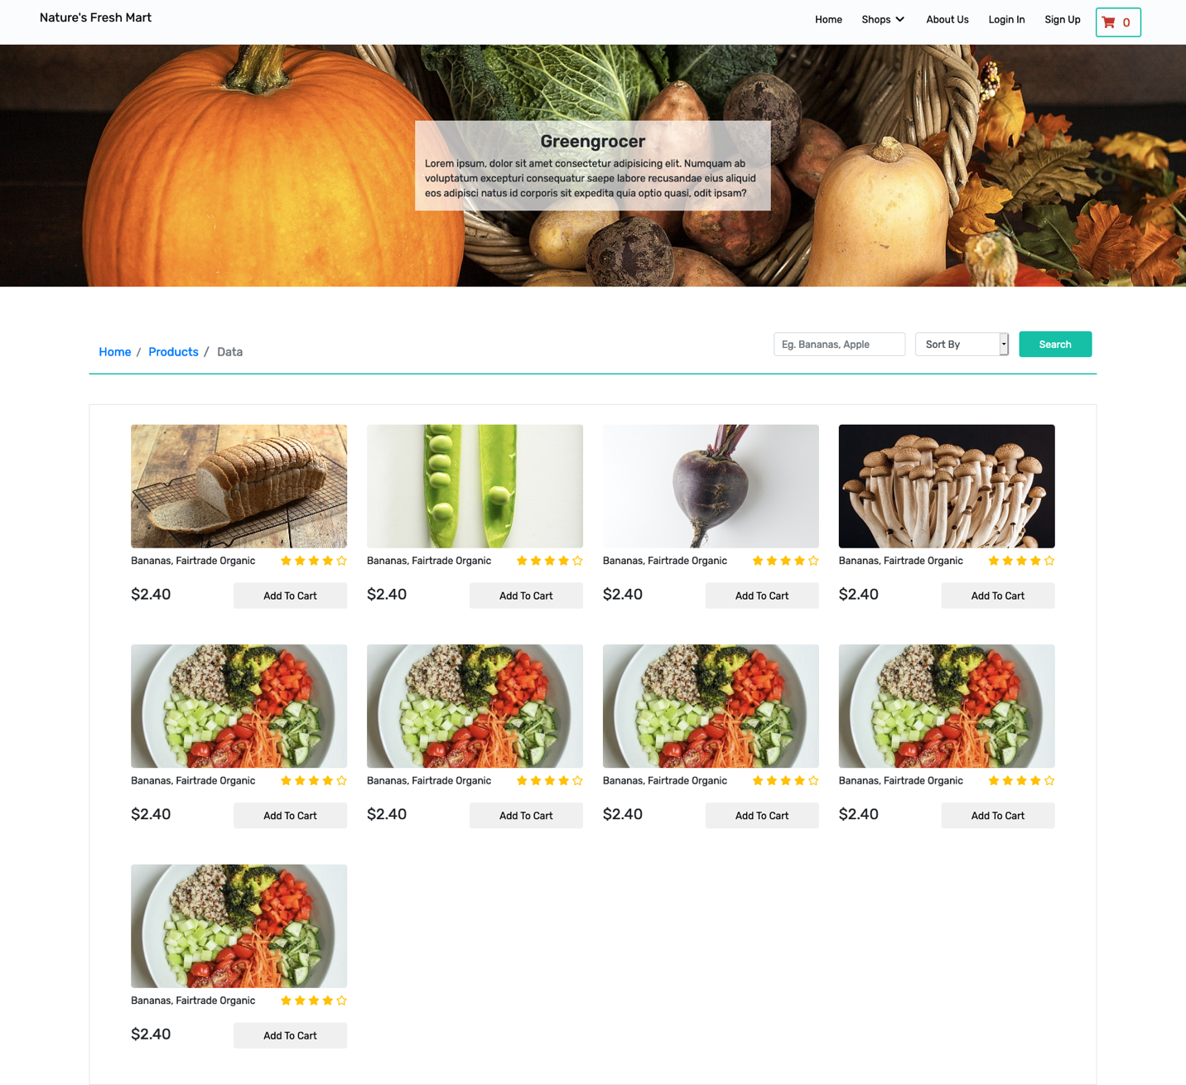
Product page Section

Slide 61
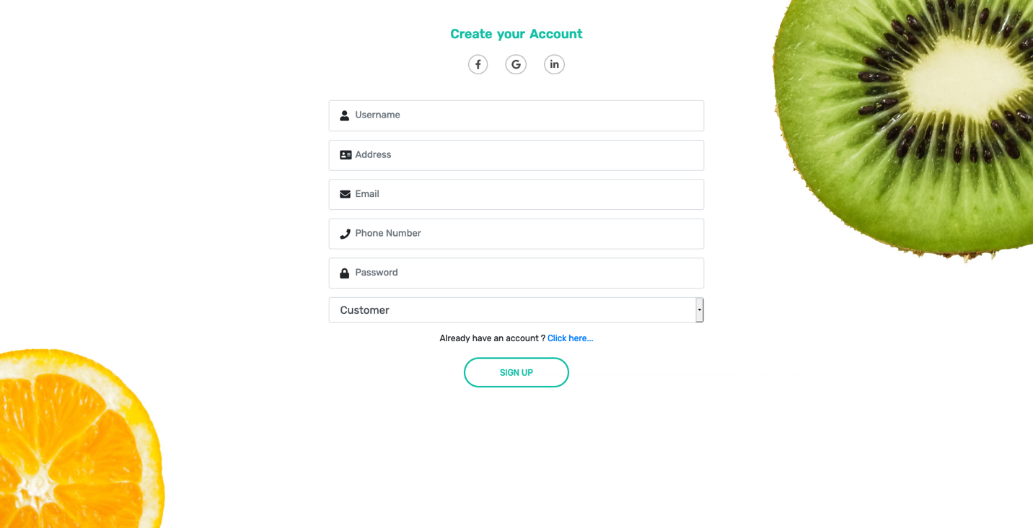
Sign Up page Section

Slide 62

Thank you!
Hope you liked our presentation!

